Slide 1
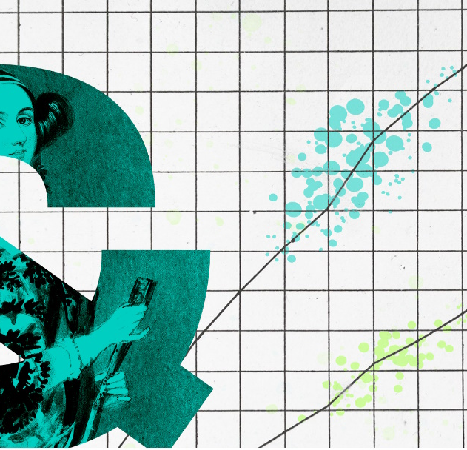
Model Assumptions

Slide 2
Model Assumptions: Linear regression
Nature of the model
- the relation between predictor and outcome has to be linear
Nature of the errors (i.e., residuals)
- normal and independent of each other

Slide 3
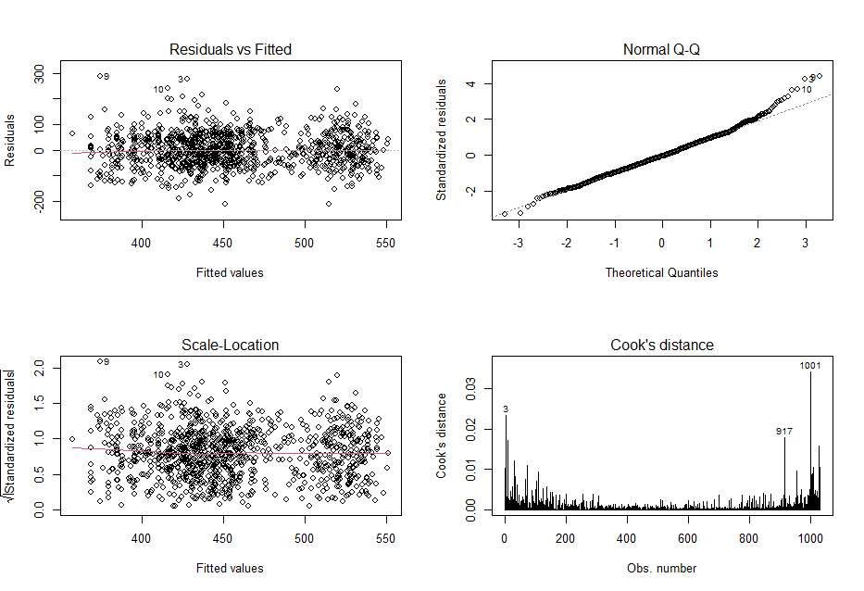
Model Assumptions: Simple regression lm()
Required(LINE):
- Linearity of relationships
- Independence of residuals
- Normality of residuals
- Equal variances for residuals
Desirable:
- uncorrelated predictors
(no collinearity)
- no outliers
Notes:
Independence of residuals: requires each residual should not be affected by other residuals; No easy way to check it, depends on the source of the observations, one determinant might be a participant observed multiple times, i.e. REPEATED measures, in which case the independence assumption is violated, mixed effect should be used
For Cook’s distance, distances over 1 are worth looking at. In general below 1 is good

Slide 4
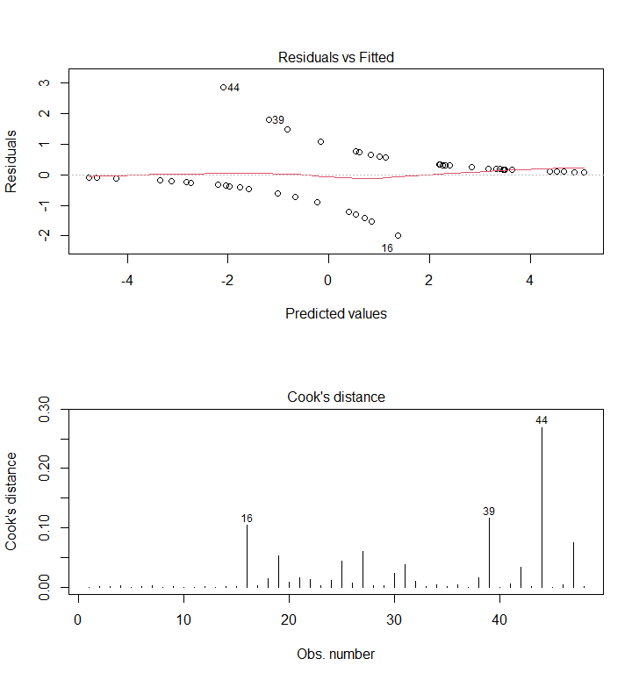
Model Assumptions: Simple regression glm()
For binomial DVs, (logistic regression)
Required:
- LINEAR relationships between IVs and log-odds
- Normality of residuals
- homogeneity of variance
- Independence of residuals
Desirable:
- uncorrelated predictors (no collinearity)
- no “bad” (overly influential) observations
- large samples (due to maximum likelihood fitting)
Notes:
For Cook’s distance, distances over 1 are worth looking at .
In general below 1 is good

Slide 5
Model Assumptions: Mixed-effects Models
Similar to simple linear regressions model
Error is random
Residuals at multiple levels
Level1 residuals: mean = 0, variance constant (R code: residual() )
Level2+ residuals: mean = 0, variance constant (R code: ranef() )

Slide 6
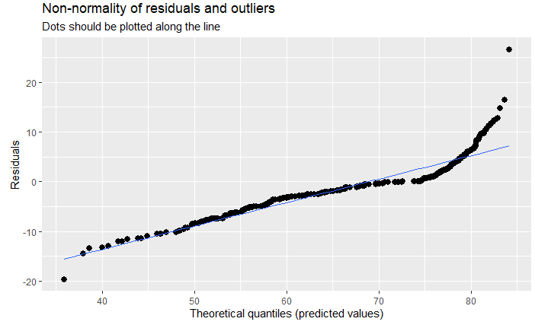
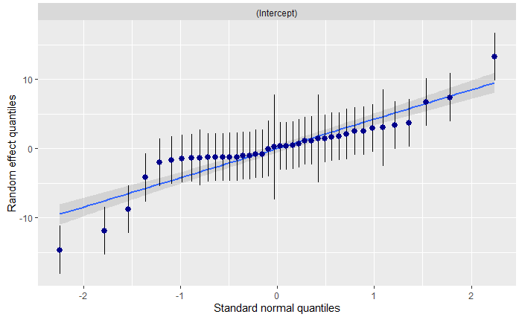
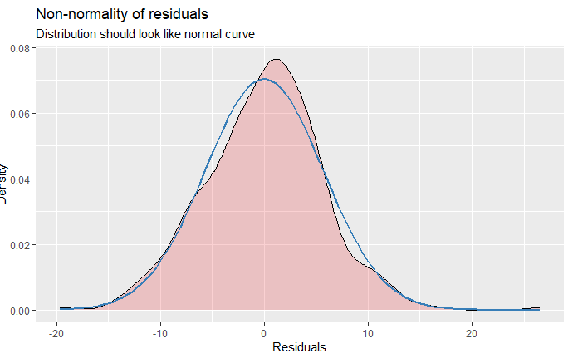
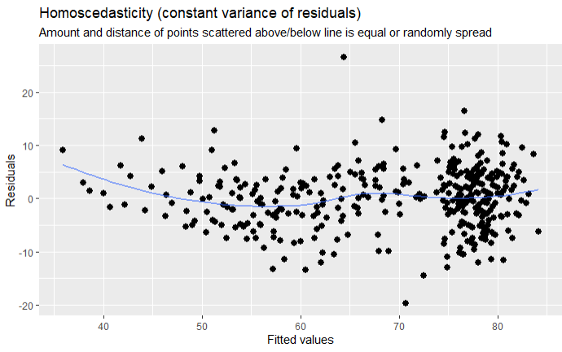
Model Assumptions: Mixed Models – lmer()
Notes:
For linear (mixed) models, this function produces plots for:
multicollinearity (i.e., check Variance Inflation Factors);
QQ-plots: checks for normal distribution of residuals and
homoscedasticity,i.e., constant variance of residuals).
Linear relationship
Independence of residuals
Homoscedasiticity :Equal variance: constant variance of residual, i.e., amount and distance of points scattered above/below line should be equal
e: constant variance of residual, i.e., amount and distance of points scattered above/below line should be equal

Slide 7
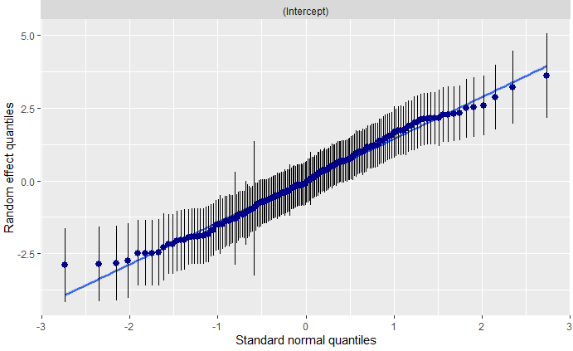
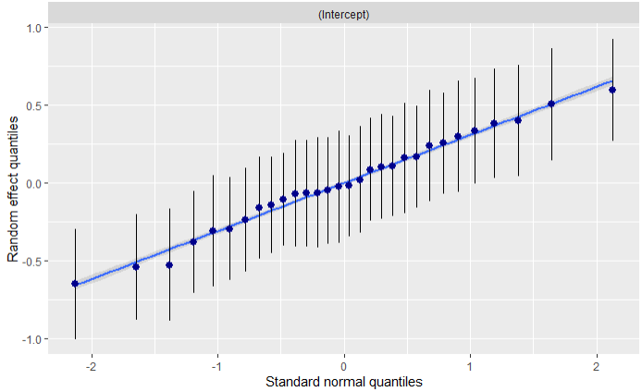
Model Assumptions: Mixed Models – glmer()
Notes:
For generalized linear mixed models, this function produces plots for the QQ-plot for random effects.

Slide 8



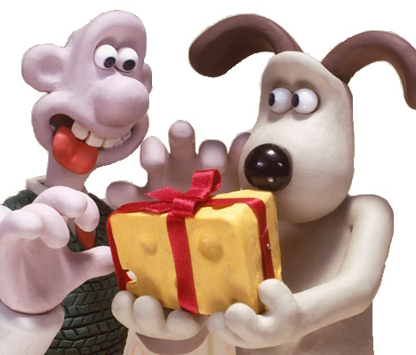
Exercise for Friday
The ‘cheese data’: Simulated data based on real psycholinguistic findings on structural priming.
Two Predictors :
2-level factor “Prime”
(a): Tom gave Spike some flowers.
(b): Tom gave some flowers to Spike.
2-level factor “communication” (video- vs audio-call)
Binary outcome: (a) or (b)?
(a) Gromit gave … (Wallace some cheese)
(b) Gromit gave … (some cheese to Wallace).

